Slide 1
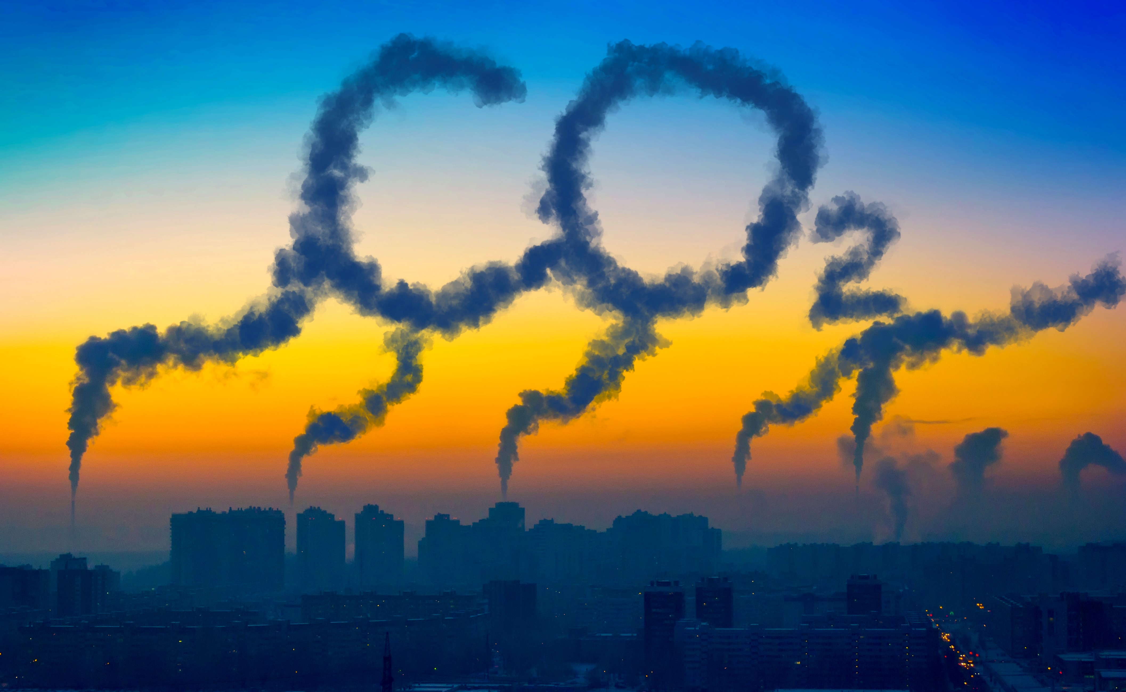
CO2 Token Ex Tokenizing CO2 and Market Making
Team #6 – Project 3
Gurpreet Sodhi, Shahan Ahmed, Nicole Mann, Etan Winograd

Slide 2

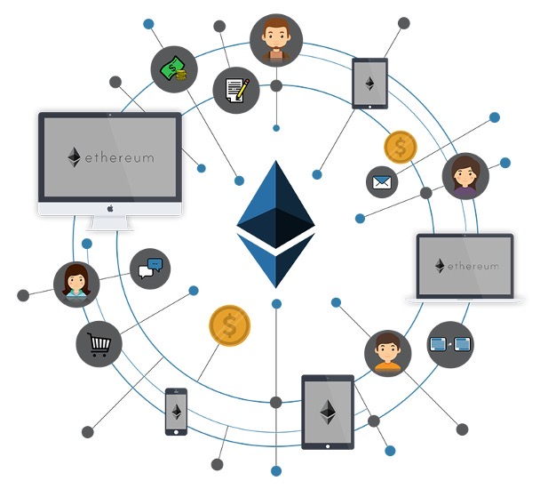
Tokenizing CO2 Assets
Digital Market
Digitalization
of Tokens
CO2
CO2
CO2
Ethereum MainNet
CO2 Tokens &
CO2 Smart Contract
Buy/Sell on Market
Physical Certificates

Slide 3
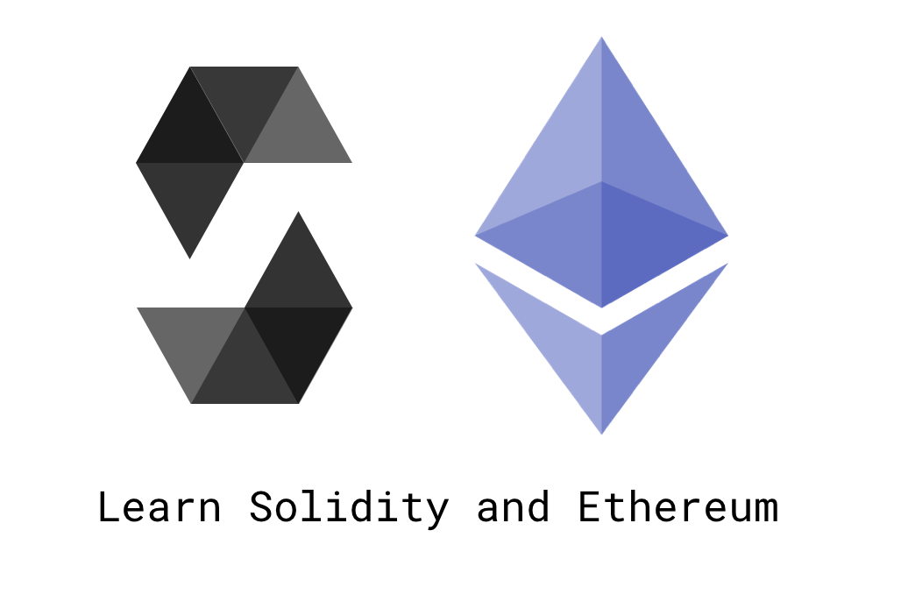

Technology Breakdown
Python – Calling smart contract functions
HTML – Markup language used for graphical Interface.
JavaScript – Processes the user interactions.
PHP – Server side communication.
Solidity – Used to define contracts
Ganache – Simulate local ethereum network

Slide 4
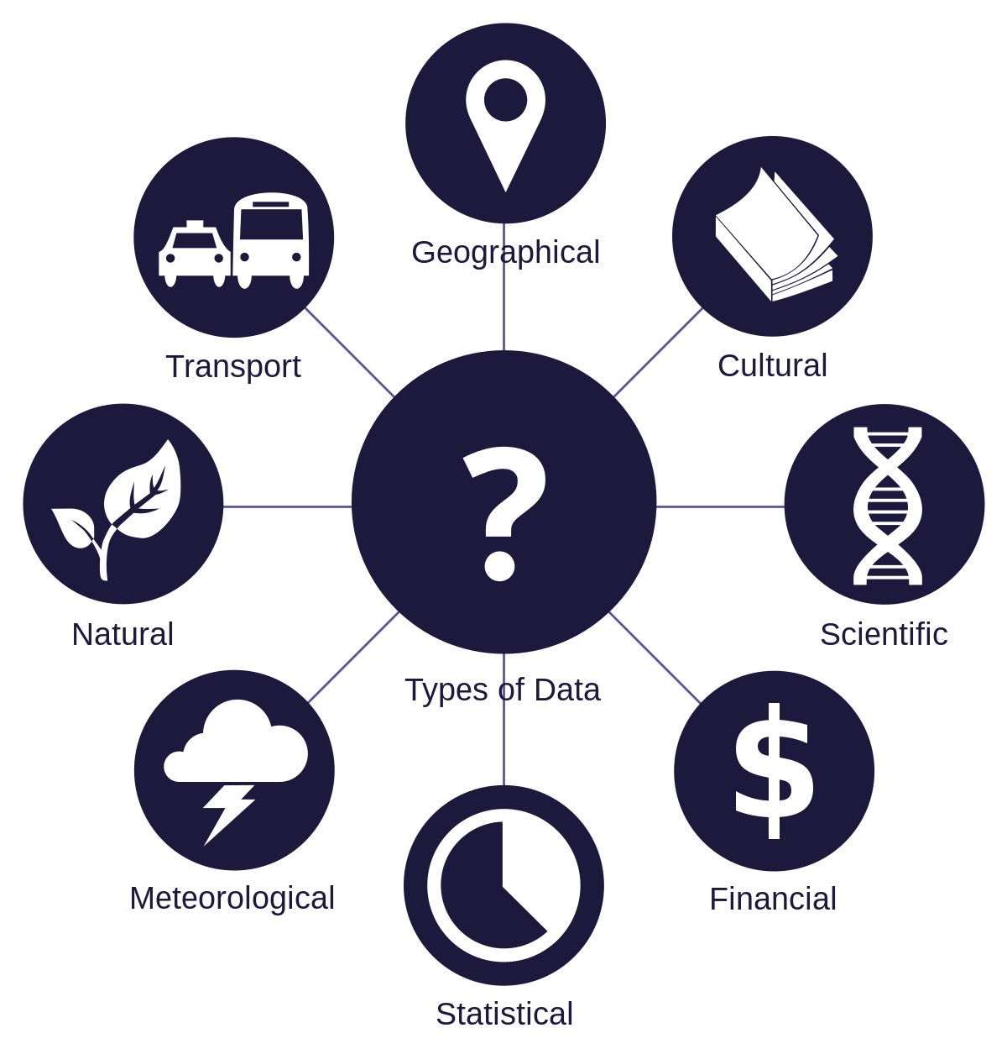
Data Preparation
Created a local object for 5 car companies.
The data includes:
Company name
Public keys
Private Keys
Type of entity (Gov. or Company)
Past percentage of carbon emissions from research

Slide 5
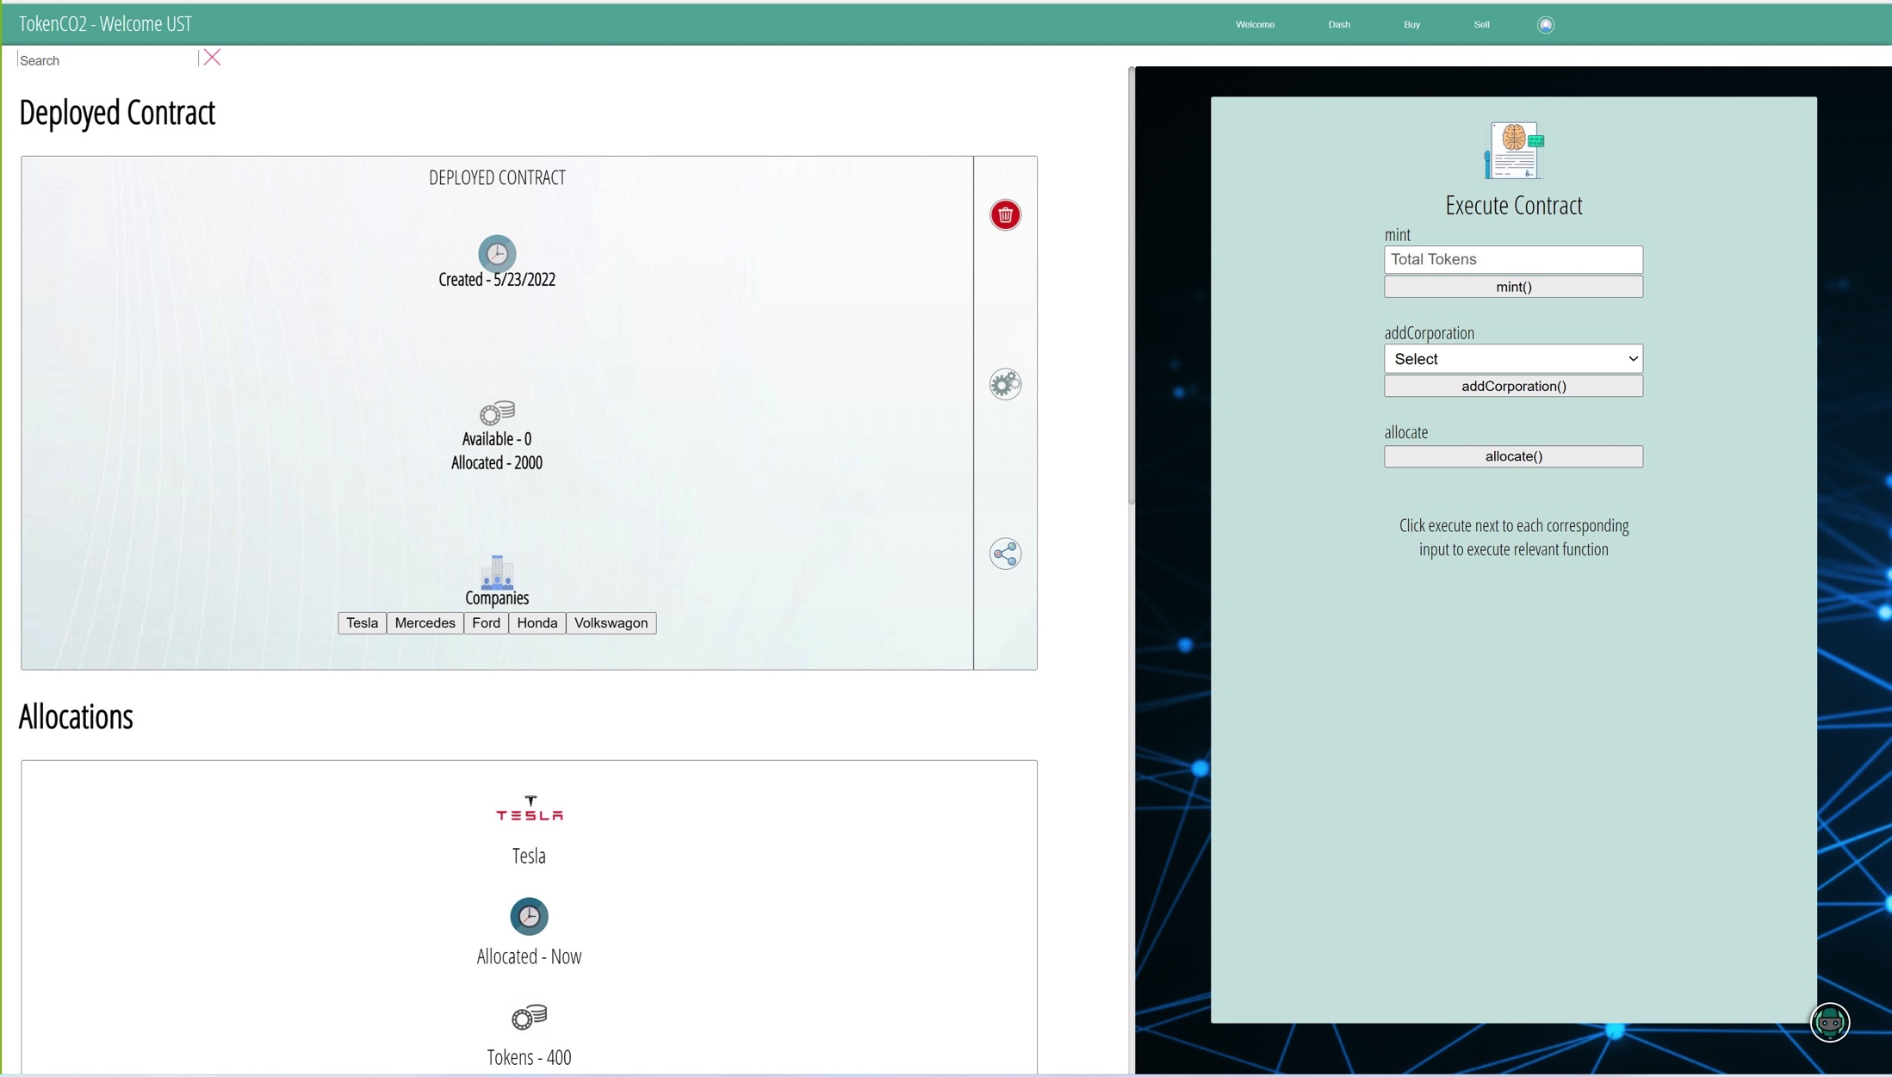
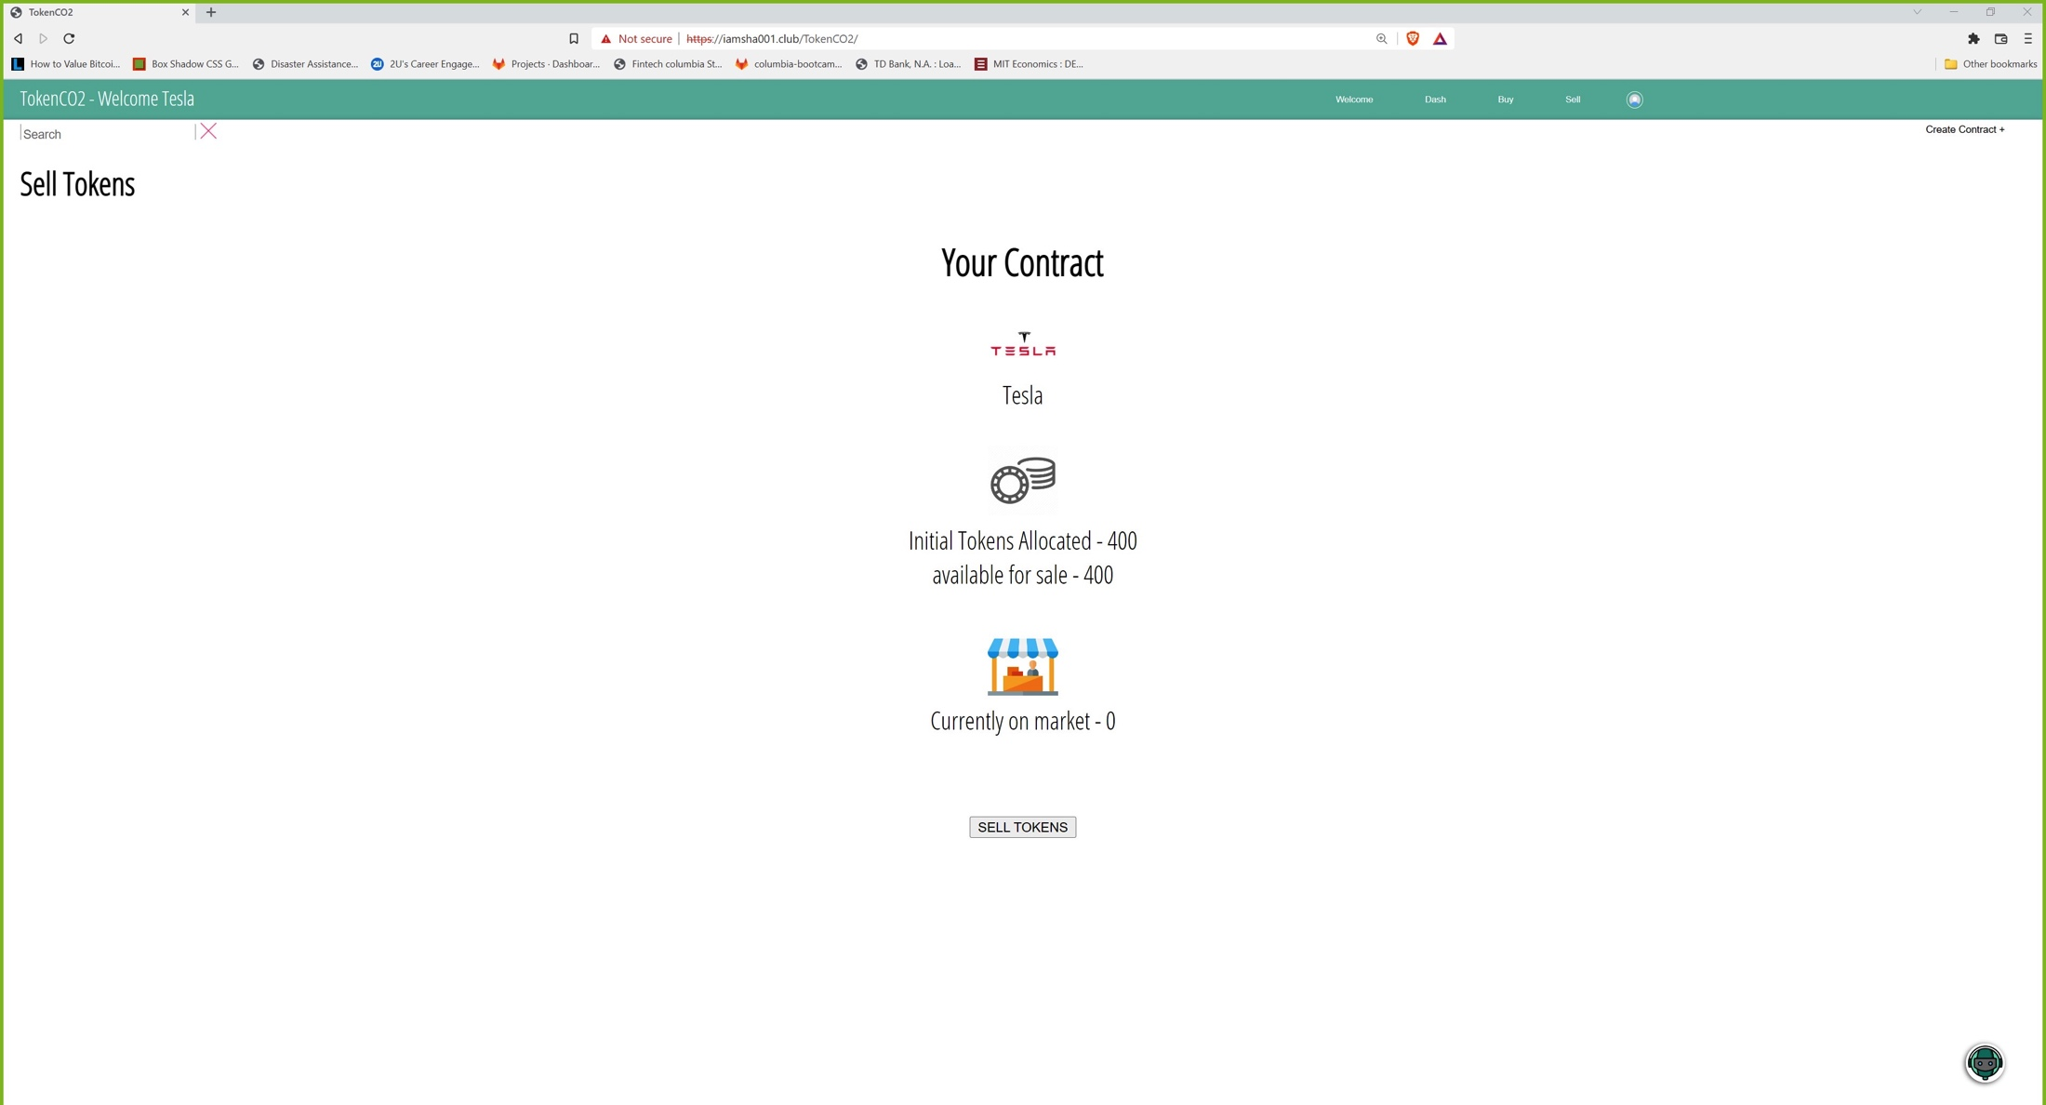
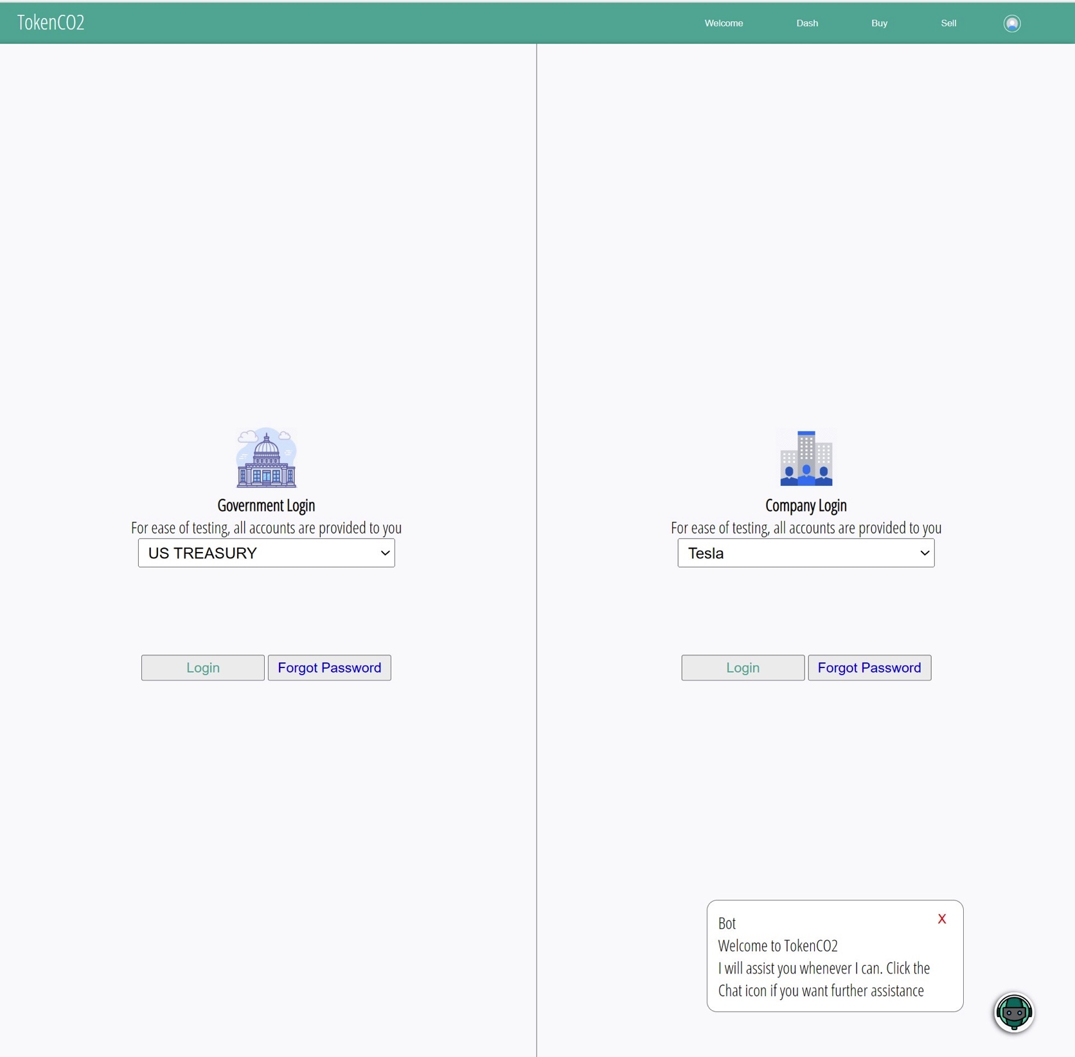
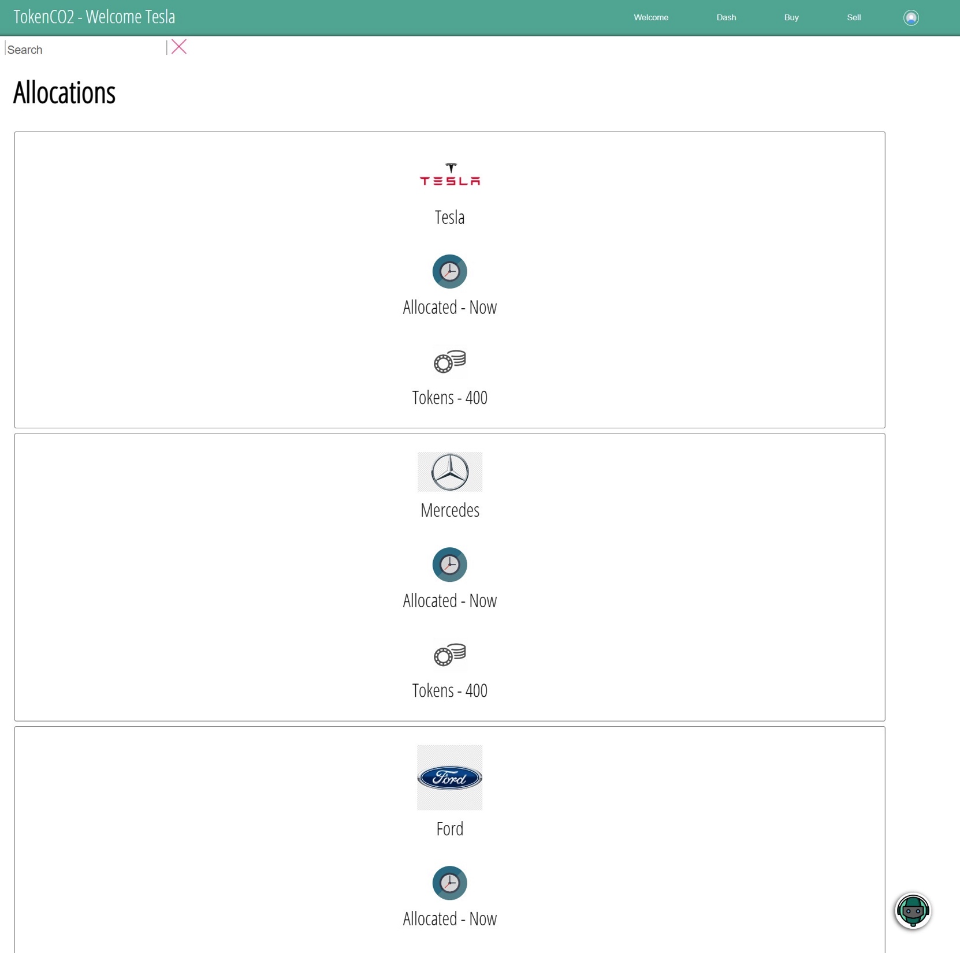
Demonstration

Slide 6
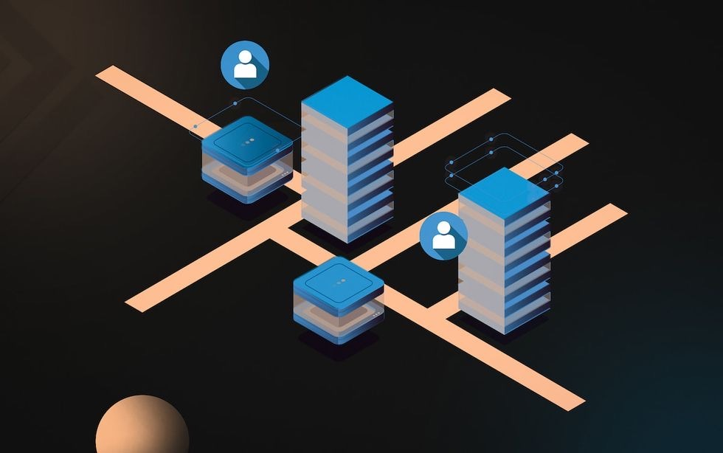
Future Enhancements
Enhance front end security
Standardize contract deployment across countries and industries
Increase chat bot functionality
Mobile application

Slide 7


Ready to Fund the Next Revolution?
Be the first to market
Make your future greener
Github Address: https://github.com/gurpreetsodhi/Columbia_Fintech_Project3
Shahan Ahmed, Gurpreet Sodhi, Nicole Mann, Etan Winograd

